Slide 1

Stadium Management System: Summer Project Report
Presented by Pooja Mahanta, Mudit Baghel, and Repalle Mahendra Varma. Mentor: Mr. Sarvesh Chopra,
School of Computer Science and Engineering, Lovely Professional University.

Slide 2
Introduction to the Stadium Management System
Our Java-based Stadium Management System provides a comprehensive solution for event ticketing and administration. It features a secure login, role-based access, and a user-friendly graphical interface, ensuring efficient event management and a smooth booking experience for users. The system is designed to be reliable and scalable, handling diverse stadium operations from event creation to ticket sales.
Seamless Ticket Booking
Efficient Event Management
User-friendly interface
Admin event creation
Seat selection (VIP/General)
Secure login & registration
Promo code application
Role-based access control

Slide 3

Core Technologies Utilized
The Stadium Management System leverages a robust stack of proven technologies to deliver a stable and scalable application. Java forms the backbone, supported by Java Swing for an interactive GUI and MySQL for persistent data storage.
Language: Java
Database: MySQL (stores events, users, bookings)
GUI: Java Swing + AWT (for interface screens)
Connection: JDBC (Java Database Connectivity)

Slide 4



System Architecture Overview
The system's architecture ensures secure data flow and efficient module interaction. Authentication is central, redirecting users or admins to their respective interfaces, with all data managed via JDBC and MySQL.
Login Module
Redirection
Data Management
Authenticates users/admins via JDBC to MySQL.
Users to TicketBookingModule, Admins to EventManagementModule.
All data securely stored/retrieved from MySQL via JDBC.
The Java Swing interface provides a responsive and intuitive user experience across all modules.

Slide 5
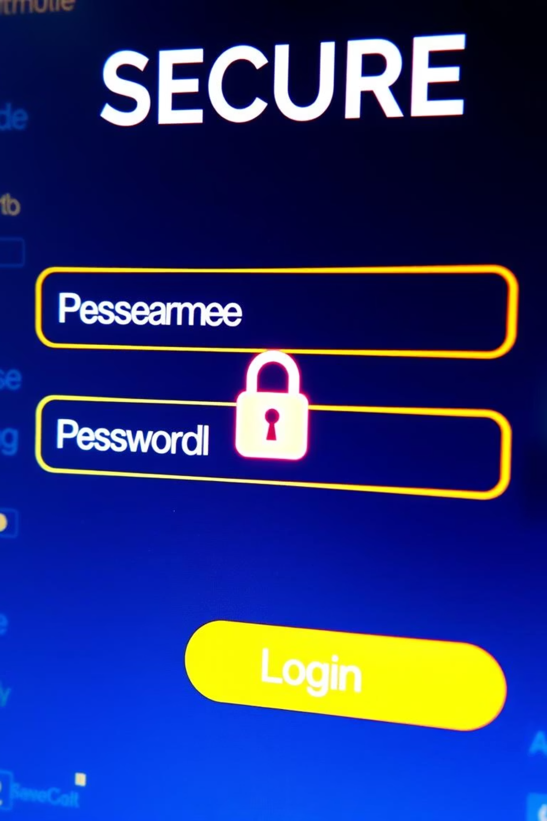
Login Module Functionality
The Login Module is the secure entry point for all users, providing a robust authentication and registration system essential for role-based access control.
User & Admin Authentication
Utilizes Java Swing GUI for secure login and registration.
Credential Validation
Verifies credentials against the MySQL database using JDBC.
New User Registration
Allows registration of new users or administrators, preventing duplicate entries.
Role-Based Redirection
Upon successful login, redirects users to the TicketBookingModule and admins to the EventManagementModule.

Slide 6
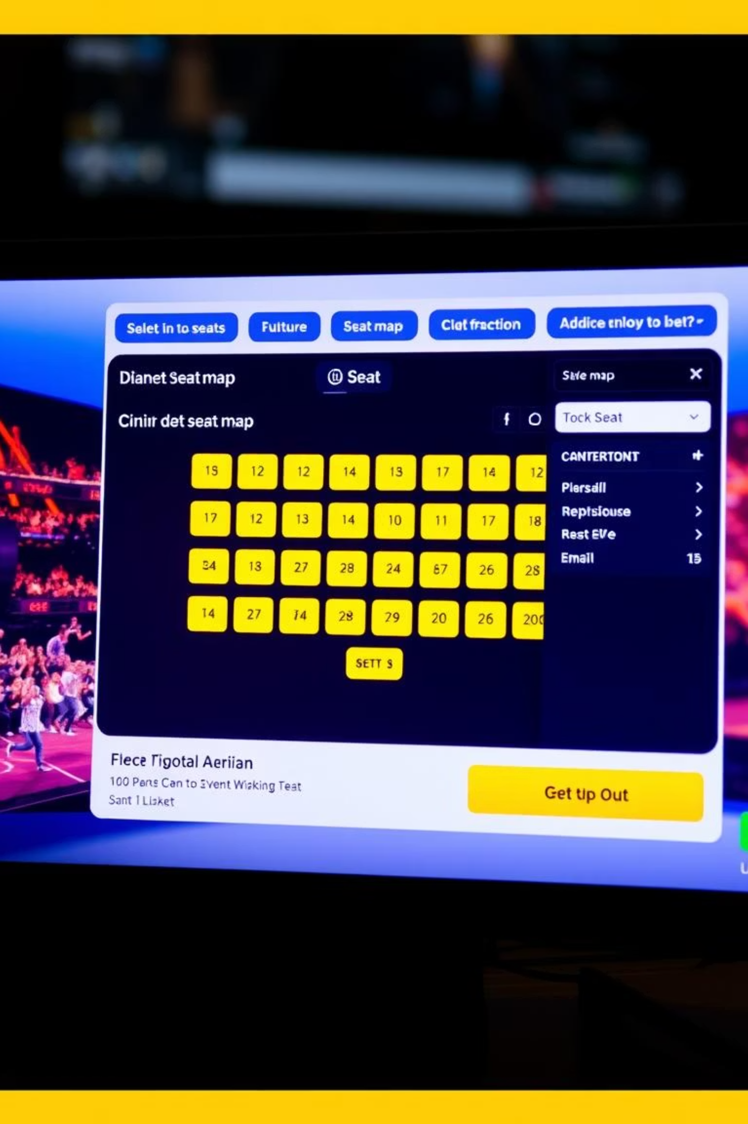




Ticket Booking Module Features
The Ticket Booking Module is designed for a seamless user experience, from browsing events to finalizing bookings with seat selection and promotional discounts.
Event Display
Browse available events with dates.
Seat Selection
Choose between VIP and General seating.
Promo Code Application
Apply valid promo codes for discounts.
Booking Confirmation
Securely stores booking data in MySQL via JDBC.

Slide 7
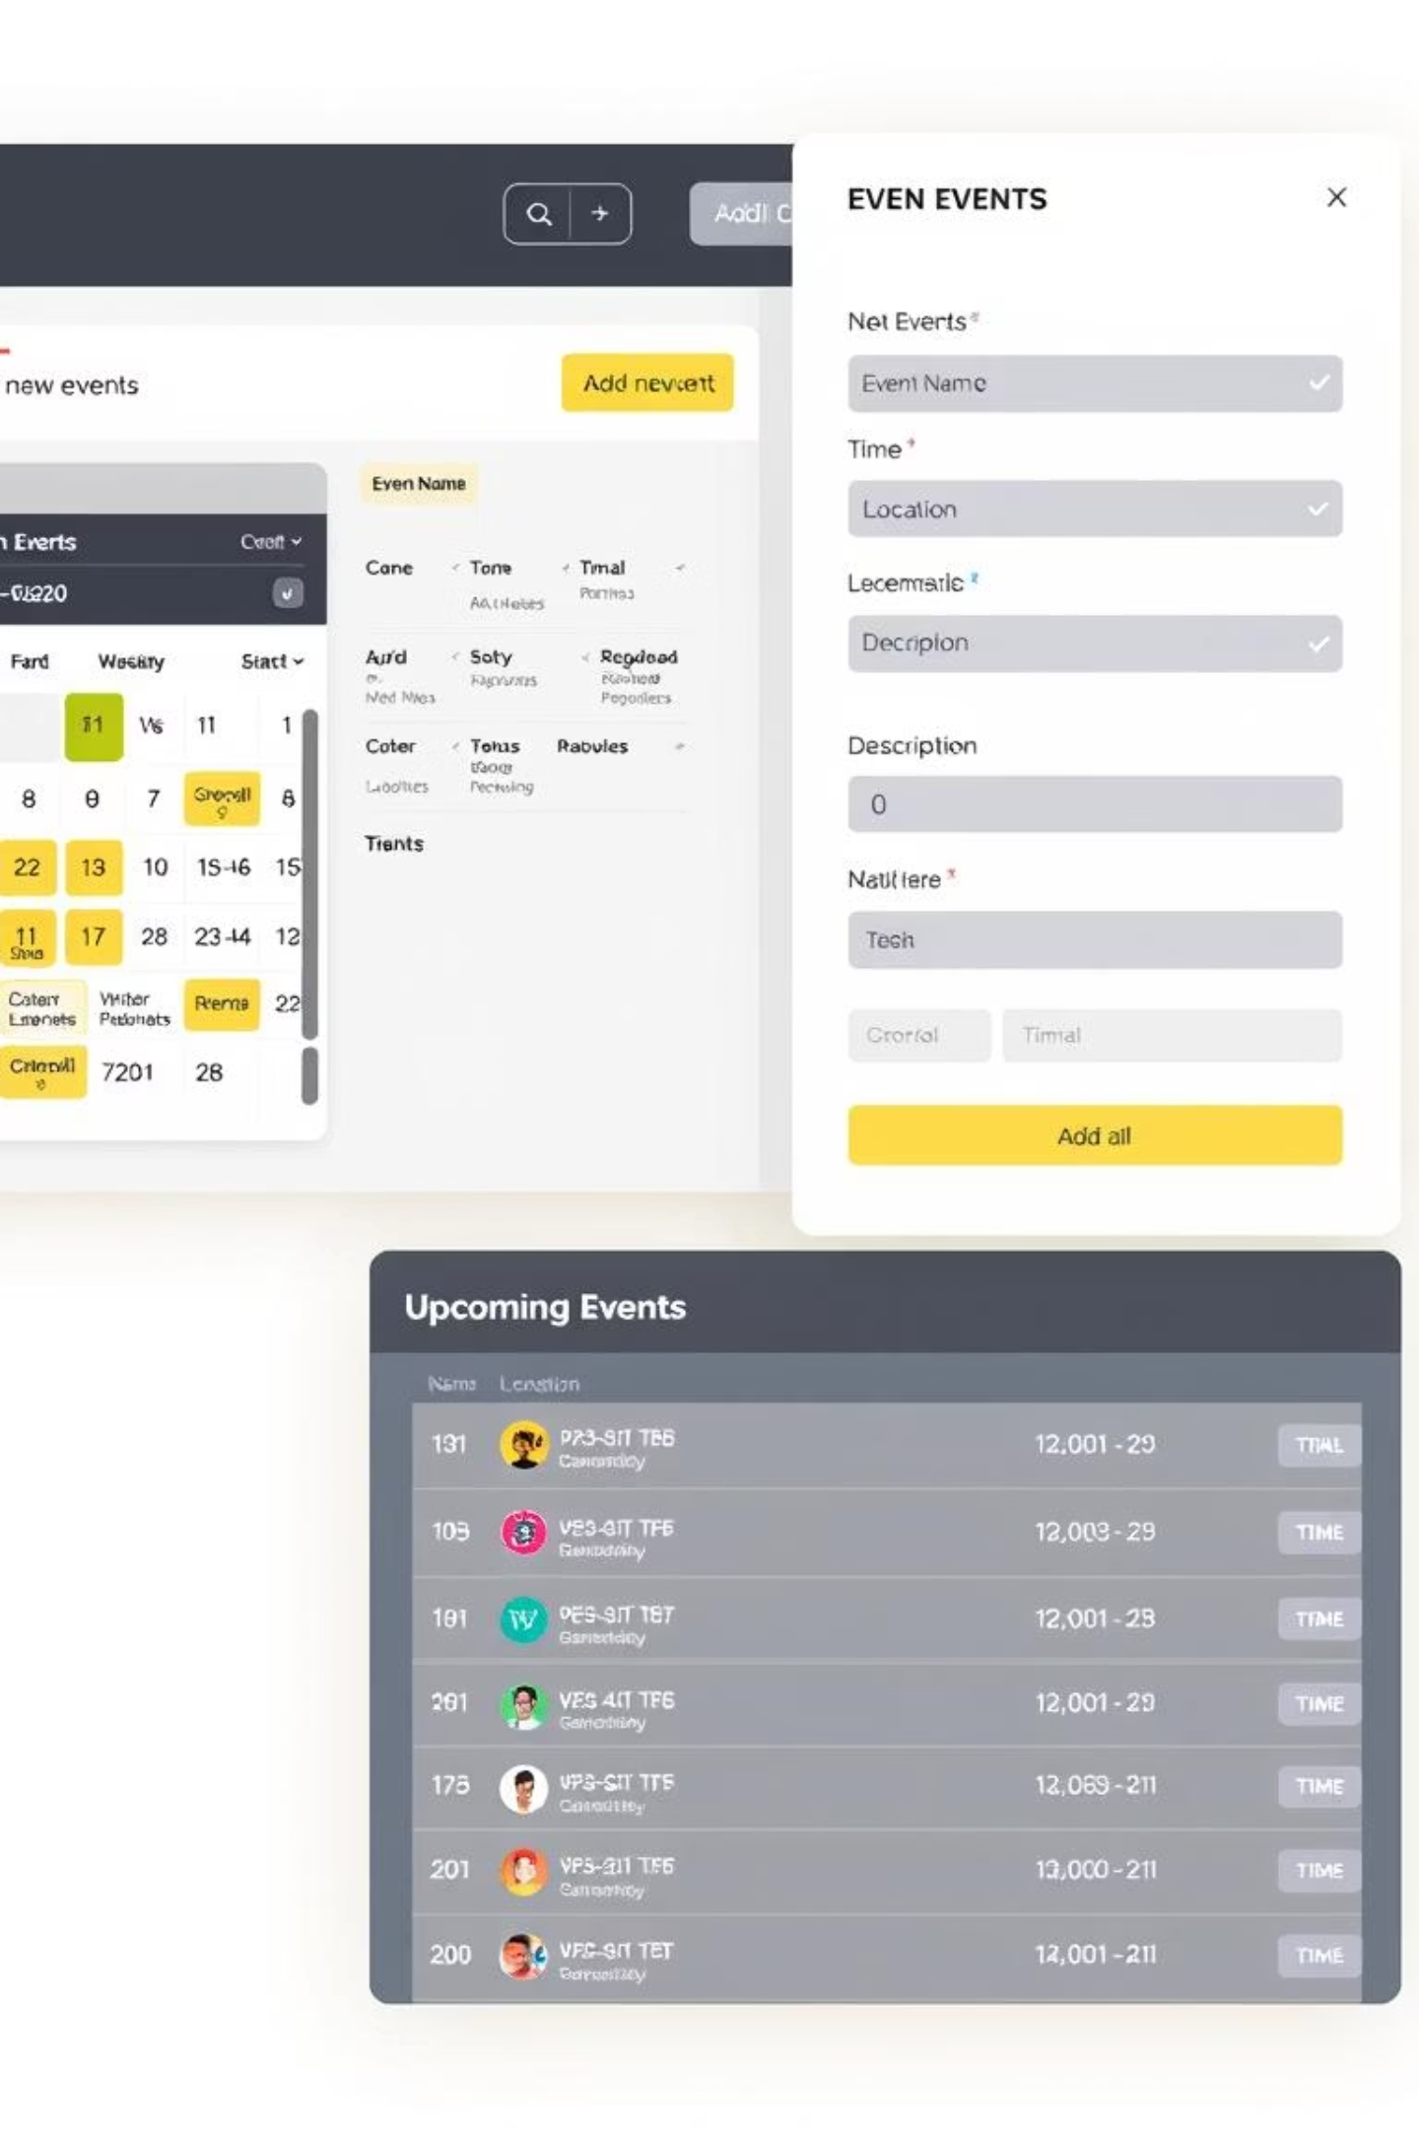

Event Management Module Features (Admin)
The Event Management Module provides administrators with comprehensive tools to efficiently add and manage event details, ensuring smooth operation of the stadium schedule.
Admin-Only Access
Accessible exclusively through role-based login authentication, ensuring secure management of events.
Add Event Details: Admins can input event name, date, time, and available seats via a form-based GUI.
Database Integration: New event records are securely stored in the MySQL database using JDBC.
User Interface: Features a user-friendly form-based GUI designed for easy event entry and management.

Slide 8
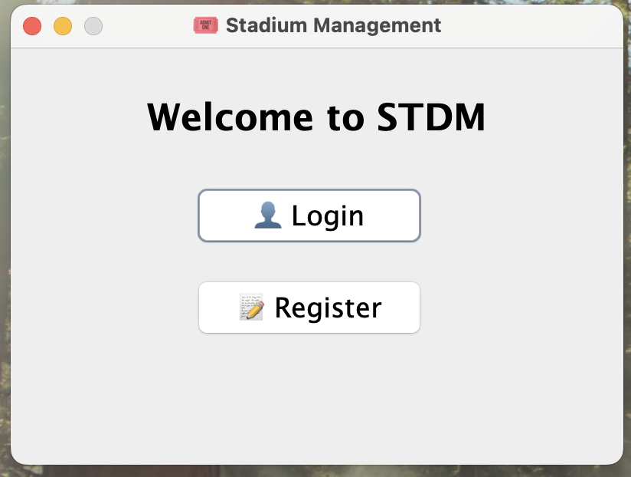
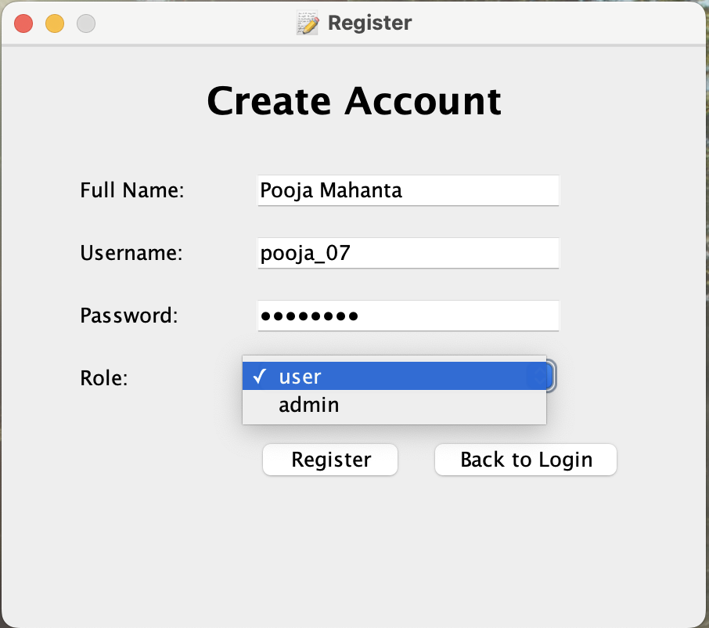
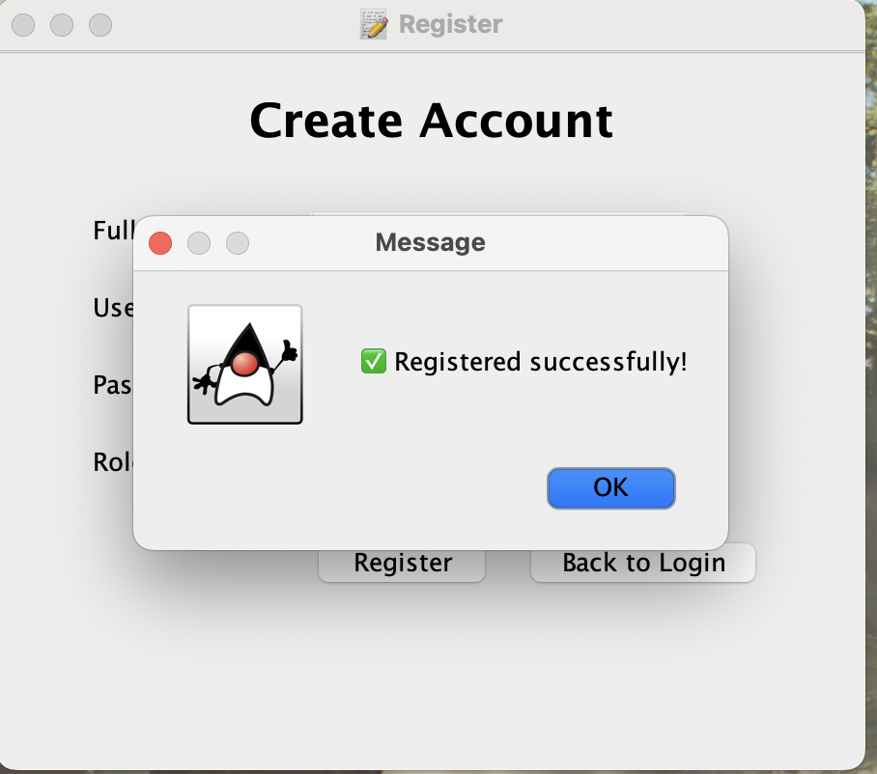
SCREENSHOTS

Slide 9
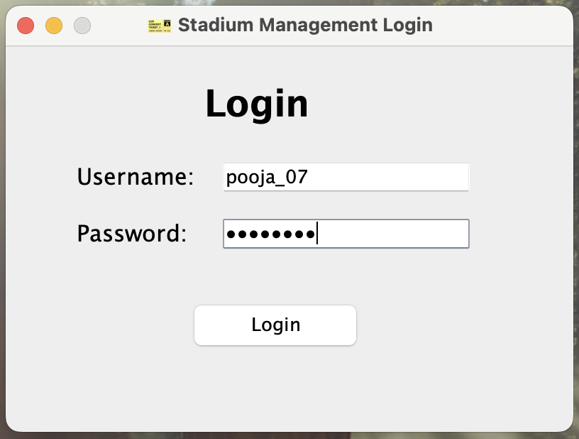
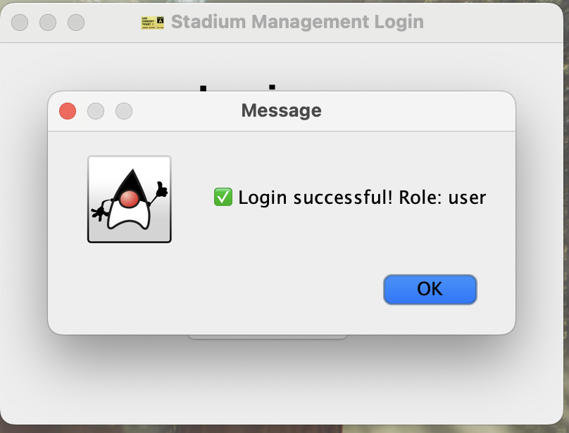
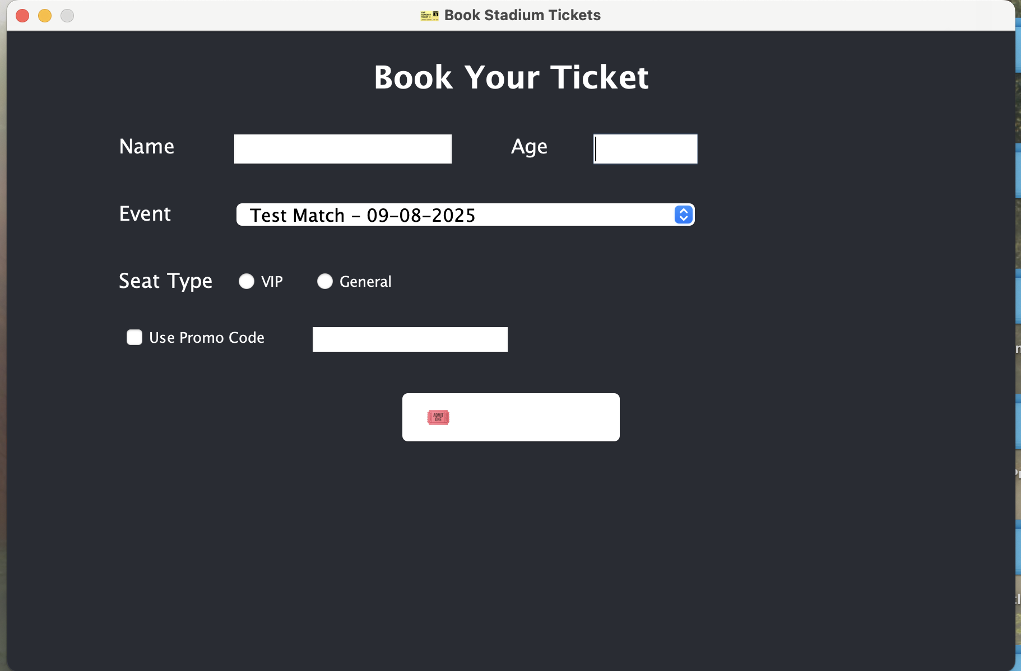
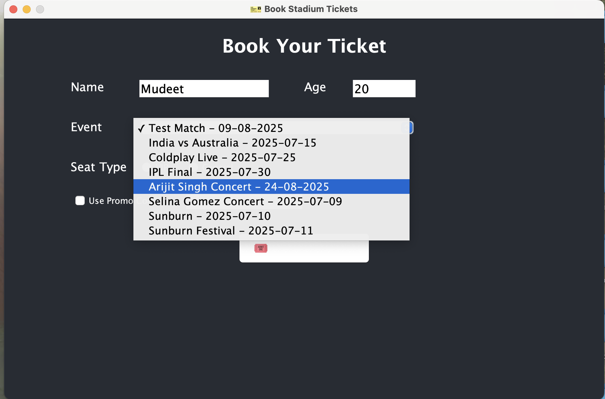
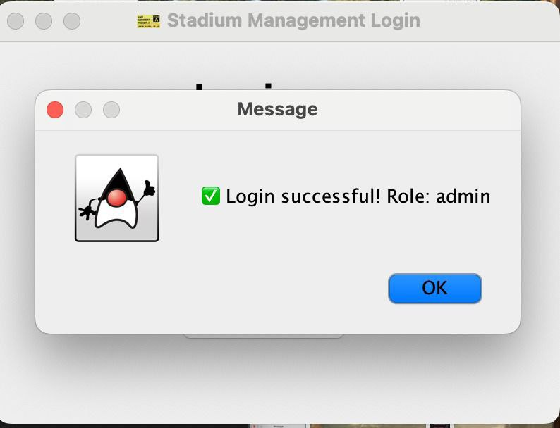
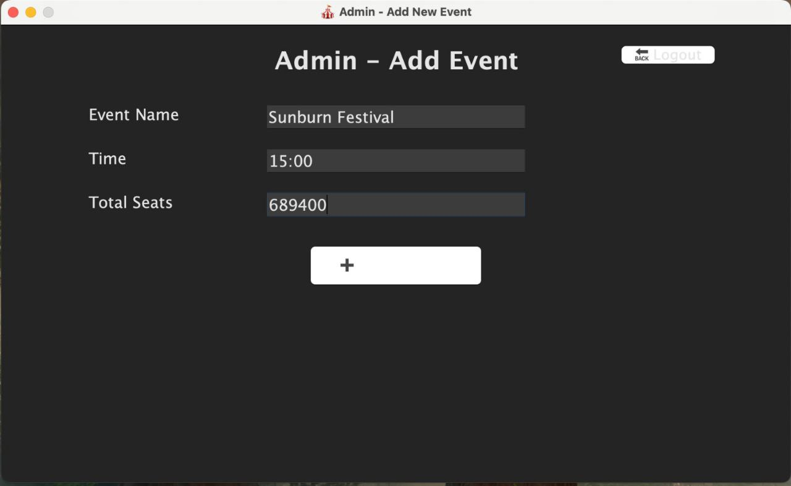

Slide 10
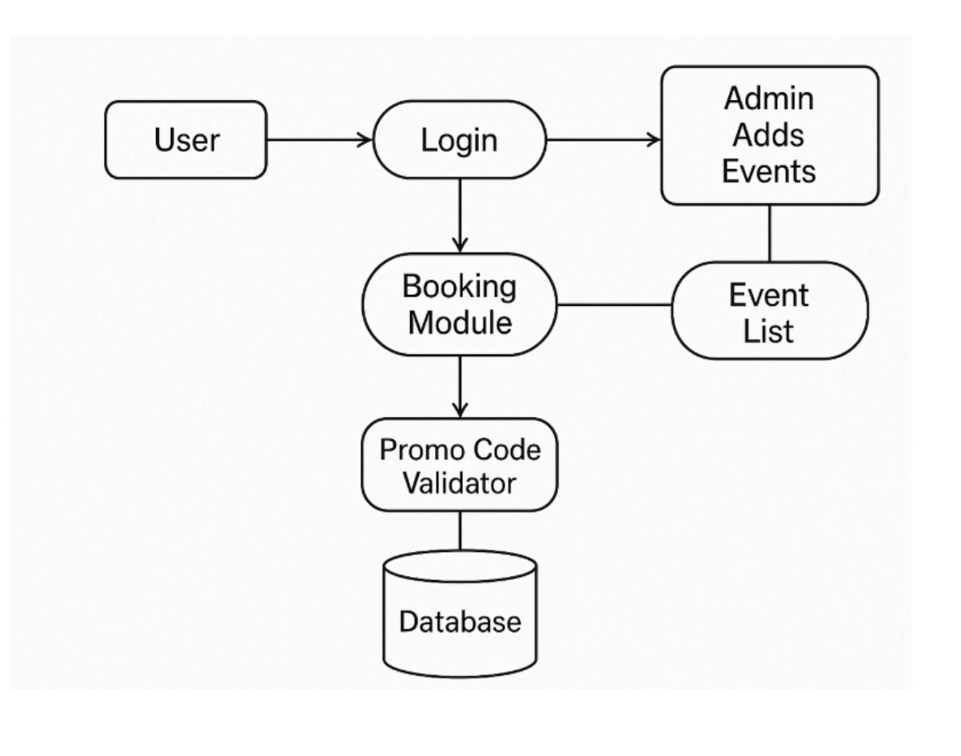
DATA FLOW DIAGRAM

Slide 11
Conclusion & Future Scope
The Stadium Management System, built with Java Swing, JDBC, and MySQL, successfully demonstrates core functionalities including secure login, event creation, and ticket booking. It provides a strong foundation for future enhancements to elevate the user experience.
While currently desktop-based, the system's modular design allows for significant future enhancements, expanding its capabilities and utility in real-world scenarios.
Key Achievements
Future Enhancements
Secure database connectivity
Promo code validation
GUI-based interaction
Online payment integration
Modular design
QR code ticketing system

